Slide 1
Perform Career Analysis
of a Renowned Football Player
EDA Findings & Visual Analysis
Based on international football match, goalscorer and shootout datasets
Prepared by Omkar Pawar
EDA Findings • International Football Dataset 1

Slide 2
Dataset Overview
DATA
MATCH RESULTS
GOALSCORERS
FORMER NAMES
SHOOTOUTS
49,547
47,914
683
683
9 columns
8 columns
5 columns
5 columns
What each dataset contributes
EDA quality checks
• Results: dates, teams, scores, tournament, venue and neutral-site information.
• Goalscorers: scorer, minute, team, own-goal and penalty indicators.
• Shootouts: match, winner and first-shooter information.
• Former Names contains the same 683-row shootout structure in the notebook.
• Results: no missing values and no duplicate rows.
• Goalscorers: 44 scorer values and 254 minute values are missing; 79 duplicate rows.
• All four date columns were converted successfully to datetime with 0 invalid dates.
• No negative home or away score values were found.
EDA Findings • International Football Dataset 2

Slide 3
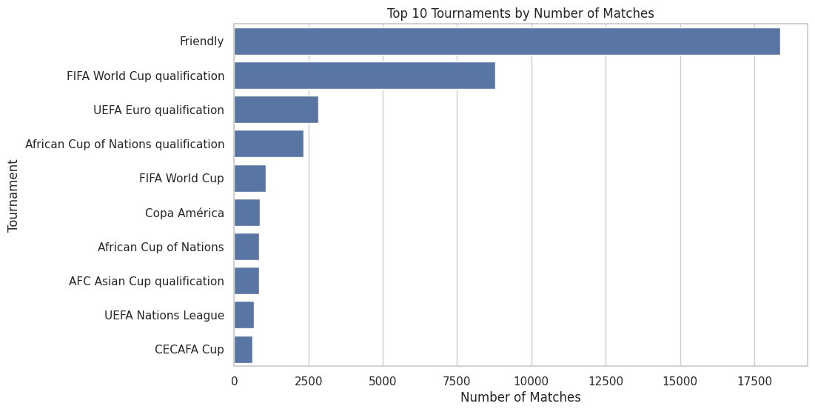
Matches by Tournament
EDA CHART
Finding
Friendly matches dominate the dataset by a wide margin, followed by FIFA World Cup qualification and UEFA Euro qualification.
This means the EDA reflects a broad mix of competitive and non-competitive international fixtures.
EDA Findings • International Football Dataset 3

Slide 4
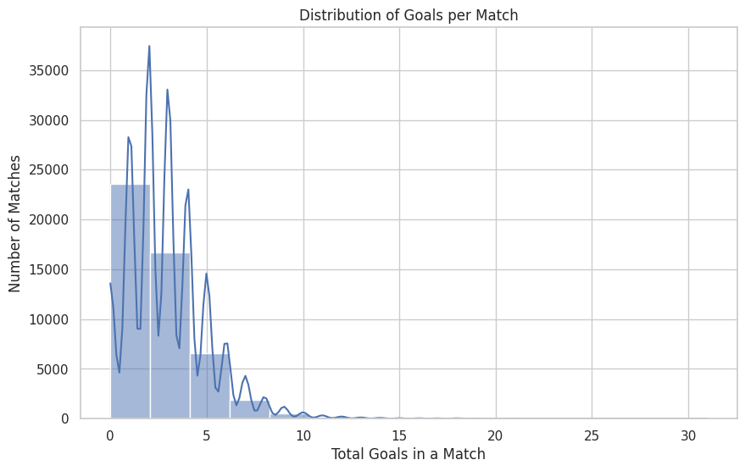
Goals per Match
EDA CHART
Finding
The distribution is concentrated in low-scoring matches, with most observations clustered around roughly 1–5 total goals.
Very high-scoring matches form a long, thin tail and are comparatively rare.
EDA Findings • International Football Dataset 4

Slide 5
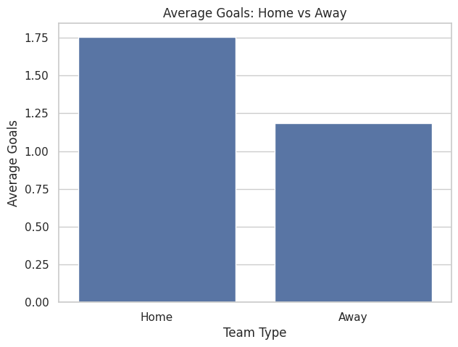
Home vs Away Goals
EDA CHART
Finding
Home teams average 1.757 goals per match versus 1.183 for away teams.
Home scoring is about 49% higher than away scoring in this dataset.
EDA Findings • International Football Dataset 5

Slide 6
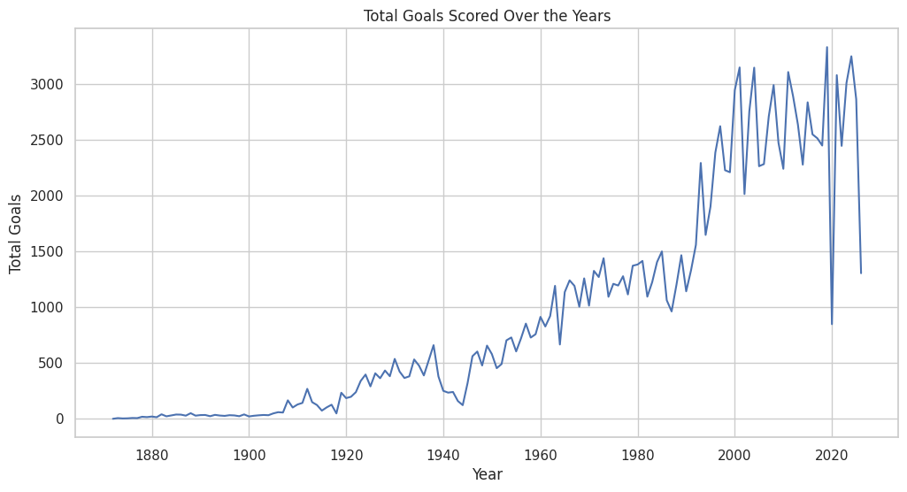
Total Goals by Year
EDA CHART
Finding
Total goals rise substantially over the long historical period, with much larger yearly totals in the modern era.
The series is volatile year to year, with pronounced peaks and dips.
EDA Findings • International Football Dataset 6

Slide 7
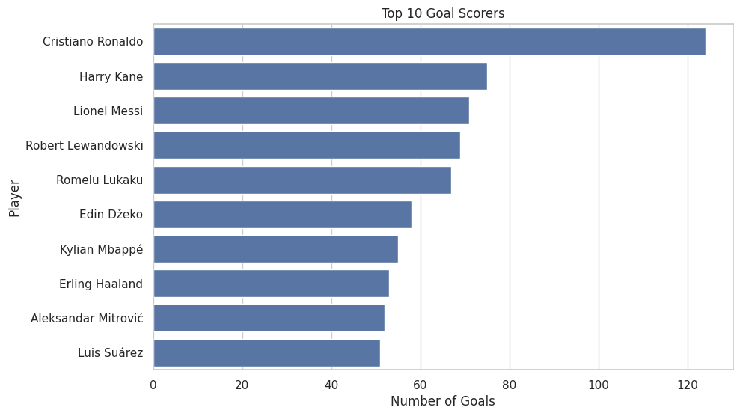
Top 10 Goal Scorers
EDA CHART
Finding
Cristiano Ronaldo leads the scorer table with 124 goals, ahead of Harry Kane (75) and Lionel Messi (71).
The gap from #1 to #2 is 49 goals, highlighting a strong lead at the top.
EDA Findings • International Football Dataset 7

Slide 8
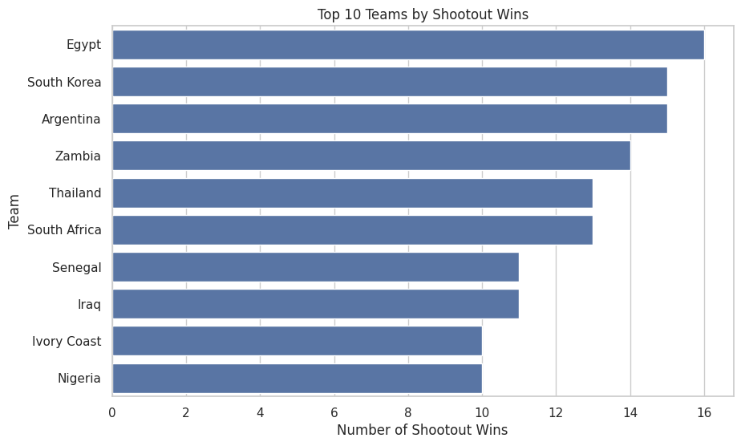
Shootout Analysis
EDA CHART
Finding
Egypt has the most recorded shootout wins (16), followed by South Korea and Argentina with 15 each.
The dataset contains 683 shootout records in total.
EDA Findings • International Football Dataset 8

Slide 9
Key EDA Findings
SUMMARY
01
Large historical coverage
49,547 match results span a very long international-football history.
02
Home advantage in scoring
Average home scoring (1.757) is materially above away scoring (1.183).
03
Low-score matches dominate
Most matches fall in a relatively low total-goal range; extreme scores are rare.
04
Modern era has higher volume
Yearly total goals become much larger in the later decades, with strong variability.
05
Ronaldo leads scorer table
Cristiano Ronaldo records 124 goals in the goalscorer dataset, 49 more than #2 Harry Kane.
06
Shootout leaders are close
Egypt leads with 16 wins; South Korea and Argentina are just one behind at 15.
EDA Findings • International Football Dataset 9

Slide 10
Conclusion
• The EDA shows a large and historically broad international football dataset.
• Scoring is strongly associated with venue context: home teams score more on average.
• International football scoring volume has expanded considerably in the modern era.
• The goalscorer analysis highlights Cristiano Ronaldo as the leading scorer in the supplied data.
• Shootout results show a small group of teams leading the recorded shootout-win counts.
EDA takeaway
Data-driven patterns reveal
scoring trends, home advantage,
and standout international scorers.
EDA Findings • International Football Dataset 10

